Slide 1
AlphaGo: The New Dominator of Go
Xu Li, Han Yu
School of Software
Notes:
Good morning, everyone. It is a great honor to speak to you today. I am Yu Han, and he is my partner Li Xu. We are from School of Software and are doing some researches on machine learning. Today, we are going to talk about alphaGo the new dominator of board game go. Recently, a big news has been discussed by a wide range of people, that is alphago beat Ke Jie. The latter is the no.1 ranked human go player in the world. Many people think that AlphaGo is invincible and feel anxious about artificial intelligence. Here, we are going to talk about the core of alphago, including how it works, why it is invincible and what impacts it will bring to our life.

Slide 2
Header
Title
AlphaGo: The New Dominator of Go
General purpose
My purpose is to inform my audience about AlphaGo
Central idea
AlphaGo is a powerful Artificial Intelligence that will dominate Go.
Organizational patterns
Chronological order

Slide 3
What is AlphaGo
Notes:
First, let’s have an overview about what is alphago.

Slide 4
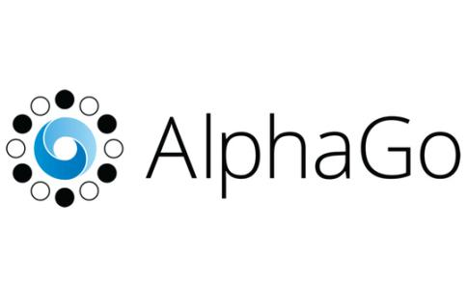
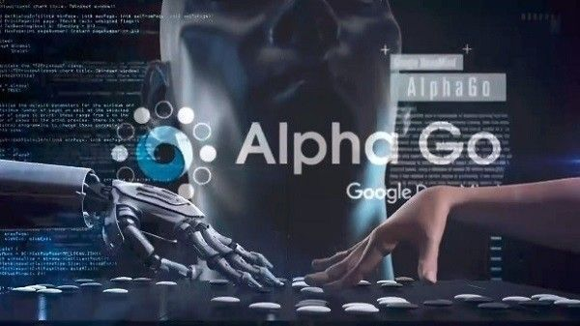
Resume
A narrow AI computer program playing the board game Go.
Producer:
Alphabet Inc.‘s Google DeepMind in London
Awards:
The first Computer Go program beating a professional human Go player
Breakthrough of the Year, Science, 2016
Notes:
It is a narrow ai computer program used to play the board game go. It is developed by Google DeepMind, a lab of alphabet company in London. It has some remarkable awards: For example, it is the first go program beating a professional human go player. And it is selected as one of the breakthrough of the year by Science in 2016.

Slide 5
Splendid Records
Kejie: World No.1 Ranked Player
2017.05 AlphaGo 3:0 Ke Jie
Fan Hui: European Go Champion
2015.10 AlphaGo 5:0 Fan Hui
Lee Sedol: 9-dan professional
2016.03 AlphaGo 4:1 Lee Sedol
Notes:
Looking back to the history of alphago, we can see splendid records: two years ago, it beat the European Go chamoion fan hui with 5 to 0. In last year, it beat lee sedol, one of the best professional go player in the world with 4:1. Some people believes that the only defeat is to gain a world rank because according to the rule of go global ranking, only when you get a defeat, can you get a rank.

Slide 6
How does AlphaGo work
Notes:
Next, lets welcome Li Xu to talk about how alphago works in detail.

Slide 7
Prerequisite
Deep Learning
Neutral Network
Machine Learning
Notes:
To understand how AlphaGo works, we need to make clear these three concepts: machine learning, neutral network and deep learning, which are the key technologies of AlphaGo.

Slide 8
Machine Learning
Machine Learning is a kind of special program!
What is a Program?
A Program is a process. With a input X, it returns a corresponding output Y.
Program
X
Y
What is Machine Learning?
With a series of input X, it returns a program.
X1
Machine Learning
Program
X2
…
Xn
Training Set
Notes:
To understand what machine learning is, we may start with another question: what is a program. A program is a process. With an input X, it will return a corresponding output Y. Machine learning is a kind of special program. With a series of input X, it will return a program. And the input is called the training set.

Slide 9
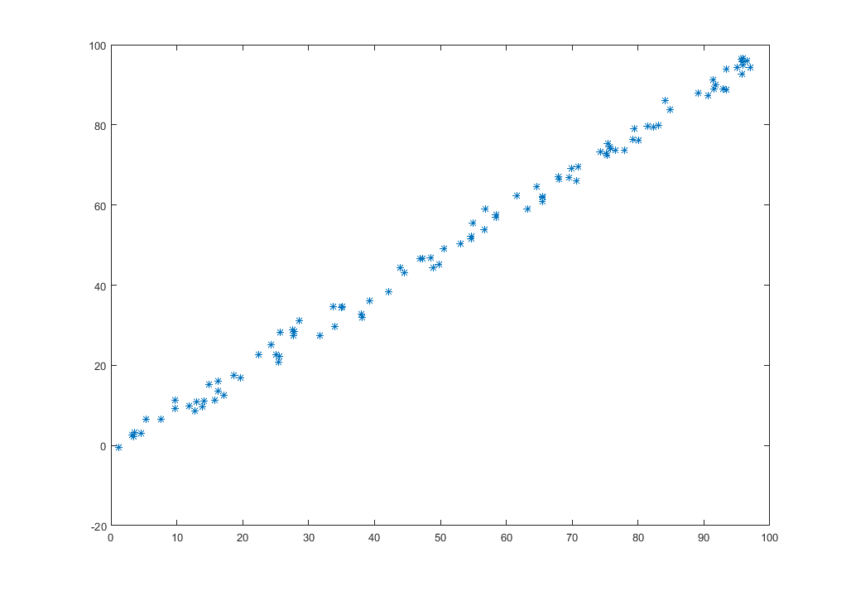
An Example For Machine Learning
Training Output：
y = x
New x: 18
Result: 18
Notes:
The history of machine learning may be older than you think. Linear regression is one of basic machine learning models. In this example, the training result of 100 points is y = x. Now given a new input x = 18, we can predict the output is 18.

Slide 10
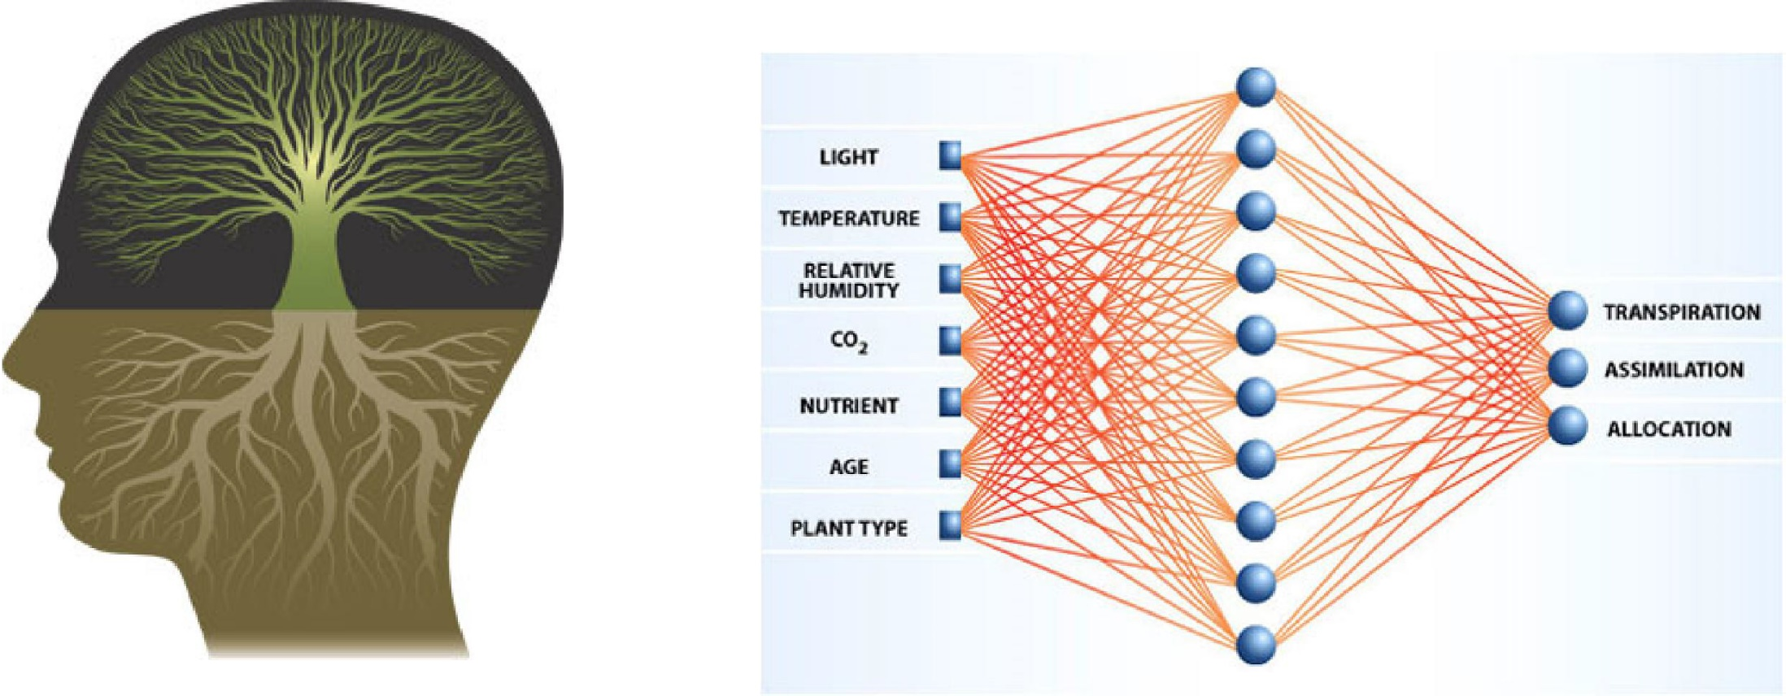
Neural Network
Input layer
Hidden layer
Output layer
Notes:
But most situations of machine learning are much more complicated. They may have multiple input features and output features. And the influence factors may be difficult to model. Inspired from neural networks, a learning model which is also called neural network is proposed. This model has three kinds of layers: input layer, hidden layers and output layer. Each unit is fully connected with the units in the interfacing layers. Each edge has a weight. Which is set to a random number at the beginning. Using the input data, the weights are adjusted gradually. Eventually, the weights will converge to optimal and we can use it to predict new values.

Slide 11
Deep Learning
output layer
hidden layer
Deep learning is a kind of neutral network with more hidden layers.
input layer
Notes:
If we add more hidden layers, this network can fit all complex models. And we have a special name for this learning method: deep learning. Now, with the understanding of how deep learning works, let’s turn our sight on AlphaGo.

Slide 12
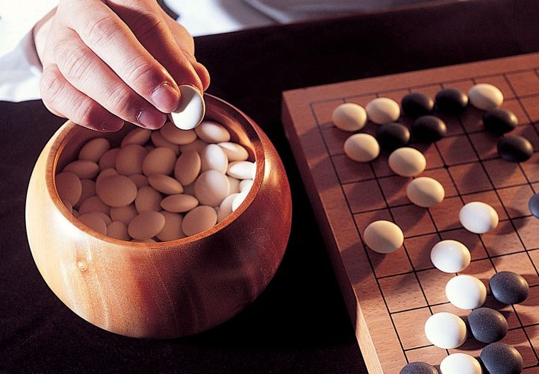
How do humans play Go
Analyze global and local situations.
Find some feasible moves.
Predict a few more steps and choose the best move.
Notes:
To let AI play go, we first need to know how humans play. The steps human playing this game can be summarized as follows:
Analyze global and local situation.
Find some feasible moves.
Predict a few more steps and choose the best move.

Slide 13
AlphaGo
Analyze global and local situation. (Position Evaluator)
X1
Board Status
Deep Learning
X2
Value Network
…
Winning Probability
Xn
Find some feasible moves. (Move Picker)
X1
Board Status
Deep Learning
X2
Policy Network
…
Feasible Moves
Xn
Notes:
AlphaGo tries to do exactly the same thing. To analyze the global and local situations, it trains a value network. With board status as inputs, it will tell you the winning probability.
And to find feasible moves, it uses a policy network. With board status as inputs, it will give you a set of feasible moves. These two networks are the fundamental of AlphaGo and both are trained using deep learning.

Slide 14
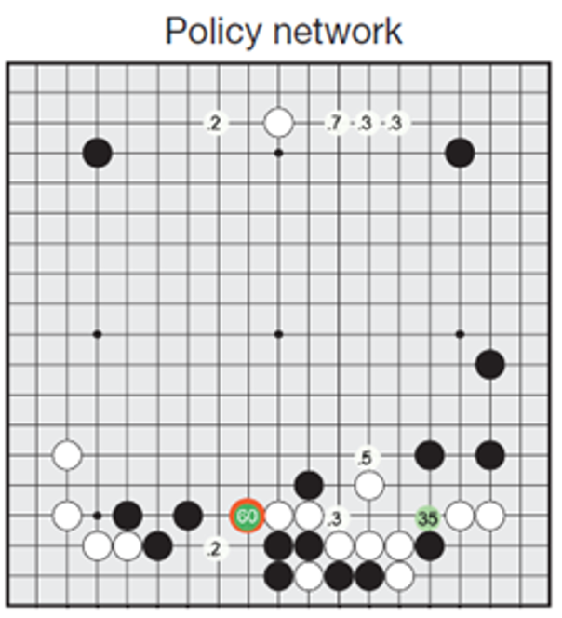
An example about how AlphaGo works
Use Policy Network to predict feasible moves.
Notes:
To let you have a better understanding, we have an example at last. The first step of alphago is to predict feasible moves using policy network. In this example, AlphaGo found 9 feasible moves. To choose the best move over 9, AlphaGo plays with itself, try each move one by one.

Slide 15
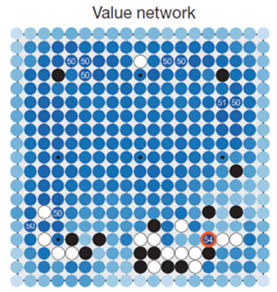
An example about how AlphaGo works
Simulation
Play with itself. Using Value Network to judge the situation.
If win/loss possibility is high, count the result and start a new iteration.
Otherwise, keep playing.
Notes:
after each move, it uses value network to judge the situation. If the situation is clear, it will count the result and start a new iteration.

Slide 16
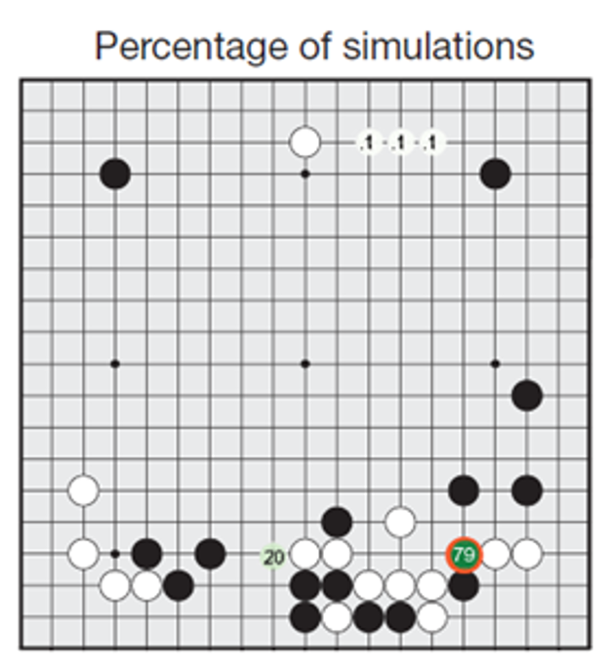
An example about how AlphaGo works
Choose the move with highest win possibility.
Notes:
After a number of competitions with itself, it eventually will get a score map. In this example, it wins 79times here, 20times here and 1time here, here and here. So the next move will be set at cross lower right.

Slide 17
Why will AlphaGo dominate
Notes:
So why alphago becomes the new dominator of go.

Slide 18
Unbeatable features
Fast
Powerful computing ability limits every prediction on next move in 2 μs.
Accurate
AlphaGo never makes mistakes guaranteed by program.
Perfect
AlphaGo never gets tired to keep every move as the best.
Notes:
There are three main reasons. First, it is very fast so that it can analyze situations more quickly than humans. This benefits from the powerful computing ability of computers. Next, it is accurate for it always runs according to what the program says and never make mistakes. And Thirdly, it is perfect because it never gets tired like human but always make the best choice.

Slide 19

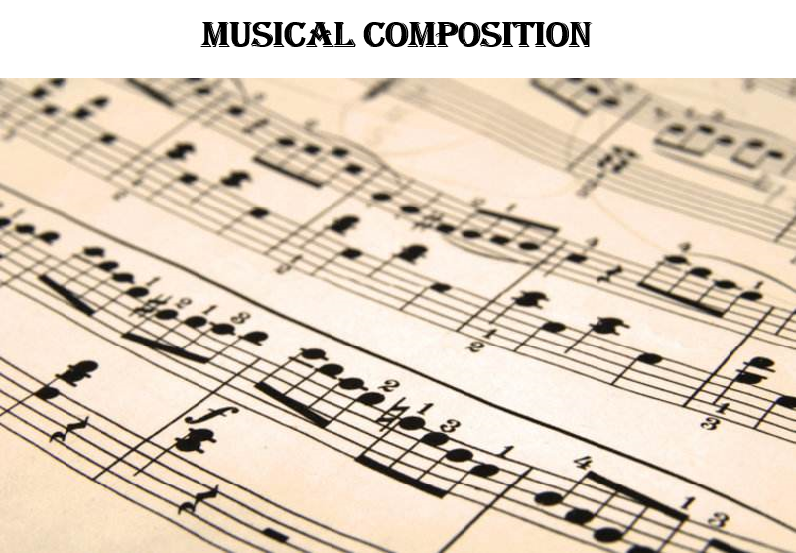
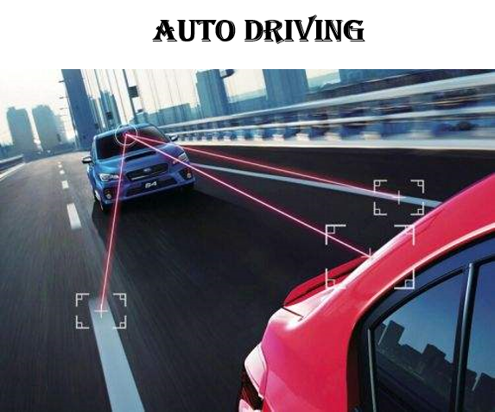

AlphaFuture
After the match between AlphaGo and Ke Jie, AlphaGo will retire while DeepMind continues AI research in other areas instead of Go.
What else can deep learning do?
Notes:
After the match with Ke Jie, alphaGo will retire. However, deep learning and AI will not. With the technologies used in alphaGo, we may have alpha-composers, alpha-listeners, alpha-paintors and alpha-drivers.
In conclusion, alphaGo shows great power in Go by using deep learning. With the wider application of deep learning, an intelligent alpha future is coming.

Slide 20
Thanks！

